Slide 1
Eseguibili con Maven
Compilare con Libreria esterna

Slide 2
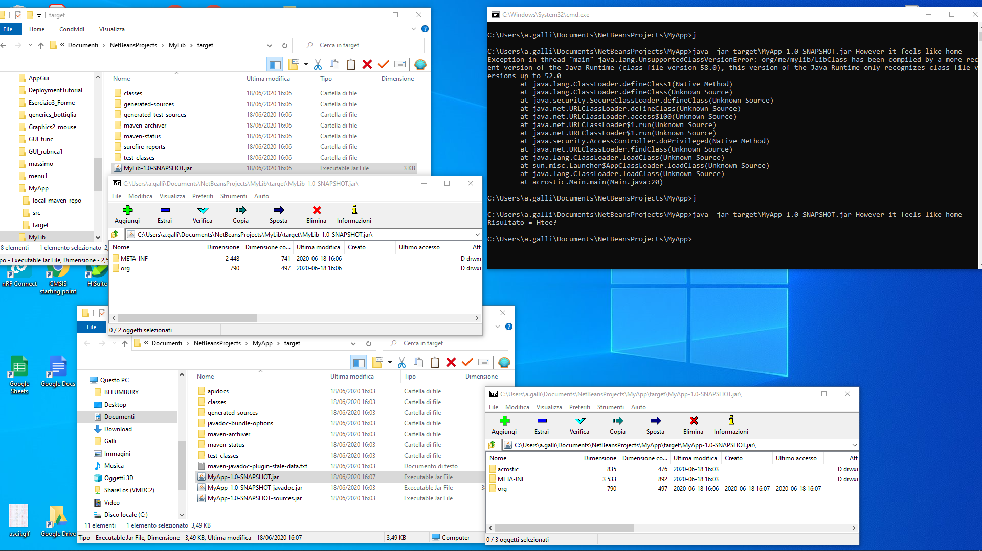
MyLib
MyApp

Slide 3
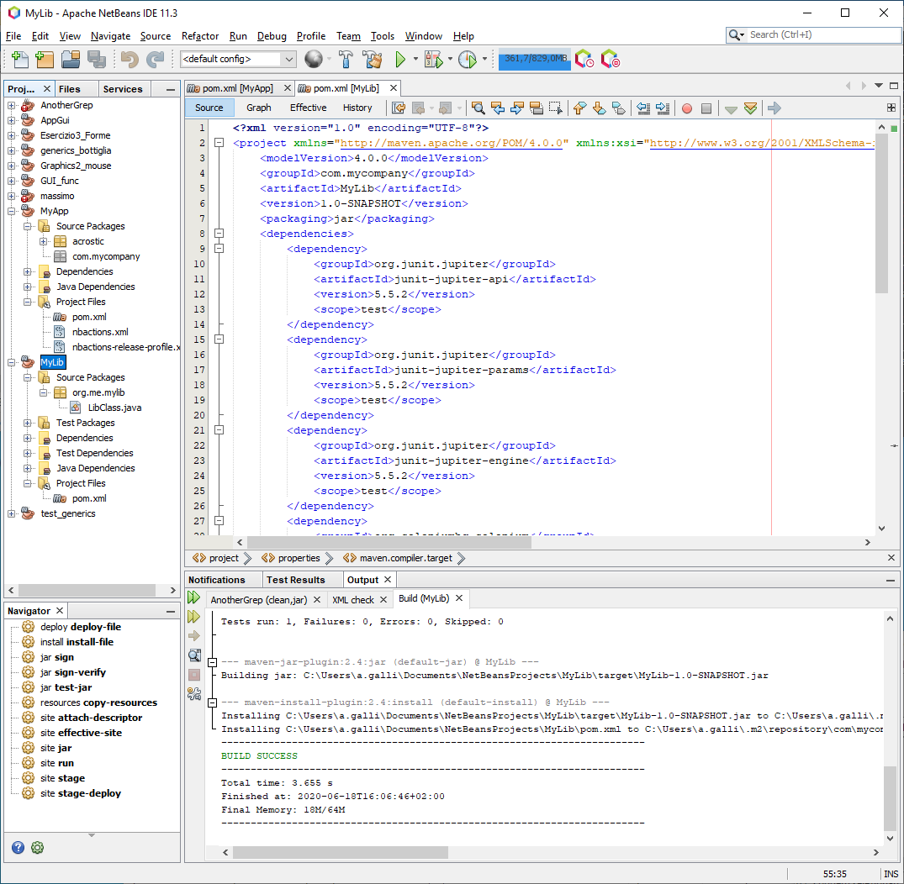
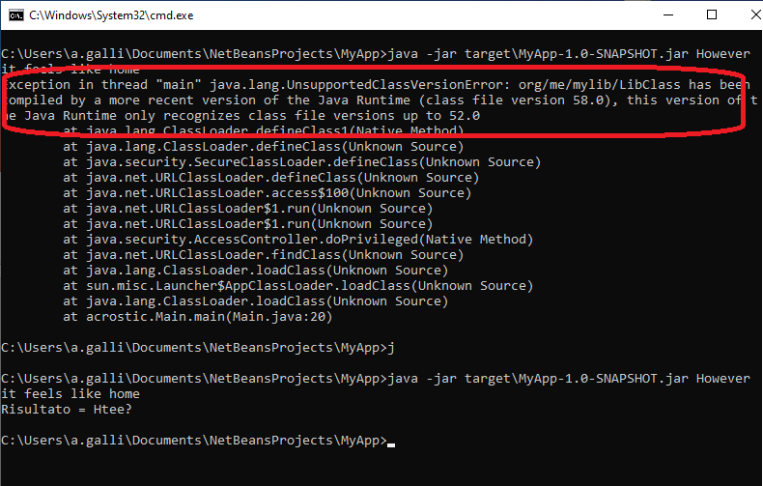
L’app è composta dal main: MyApp
E libreria esterna:
MyLib
Vanno entrambe compilate con la versione di JDK adeguata.
Per il mio JRE (runtime env) al massimo va compilata con JDK1.8 quindi setto entrambi i pom
<properties>
<project.build.sourceEncoding>UTF-8</project.build.sourceEncoding>
<maven.compiler.source>1.8</maven.compiler.source>
<maven.compiler.target>1.8</maven.compiler.target>
<maven-compiler-plugin-version>3.1</maven-compiler-plugin-version>
</properties>
Compilo prima la libreria MyLib che creerà il .jar

Slide 4
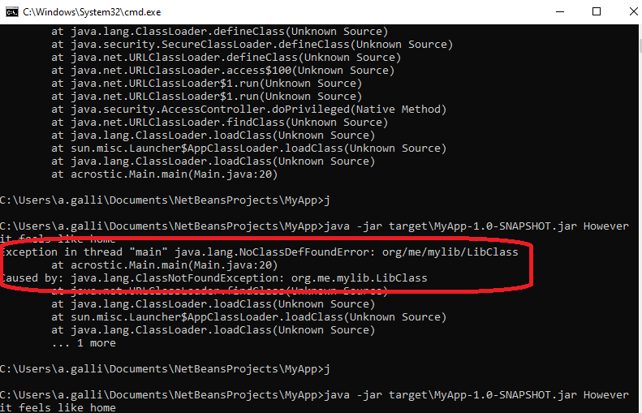
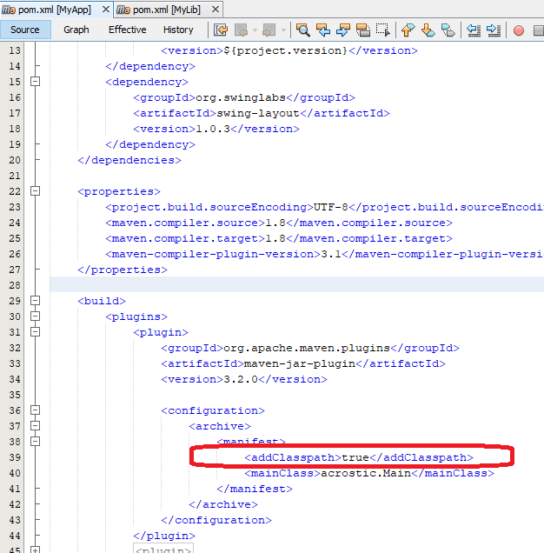
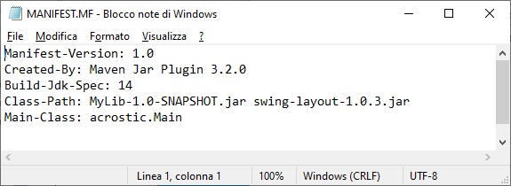
Dal MyLib .jar recupero la cartella «org» che contiene MyLib.class
E la inserisco nel .jar di MyApp
Se non lo faccio in esecuzione viene l’errore :
Nel POM di MyApp metto anche Class-Path

Slide 5
POM di MyApp
<?xml version="1.0" encoding="UTF-8"?>
<project xmlns="http://maven.apache.org/POM/4.0.0" xmlns:xsi="http://www.w3.org/2001/XMLSchema-instance" xsi:schemaLocation="http://maven.apache.org/POM/4.0.0 http://maven.apache.org/xsd/maven-4.0.0.xsd">
<modelVersion>4.0.0</modelVersion>
<groupId>com.mycompany</groupId>
<artifactId>MyApp</artifactId>
<version>1.0-SNAPSHOT</version>
<packaging>jar</packaging>
<dependencies>
<dependency>
<groupId>${project.groupId}</groupId>
<artifactId>MyLib</artifactId>
<version>${project.version}</version>
</dependency>
<dependency>
<groupId>org.swinglabs</groupId>
<artifactId>swing-layout</artifactId>
<version>1.0.3</version>
</dependency>
</dependencies>
<properties>
<project.build.sourceEncoding>UTF-8</project.build.sourceEncoding>
<maven.compiler.source>1.8</maven.compiler.source>
<maven.compiler.target>1.8</maven.compiler.target>
<maven-compiler-plugin-version>3.1</maven-compiler-plugin-version>
</properties>
<build>
<plugins>
<plugin>
<groupId>org.apache.maven.plugins</groupId>
<artifactId>maven-jar-plugin</artifactId>
<version>3.2.0</version>
<plugin>
<groupId>org.apache.maven.plugins</groupId>
<artifactId>maven-deploy-plugin</artifactId>
<version>3.0.0-M1</version>
<executions>
<execution>
<goals>
<goal>deploy</goal>
</goals>
<id>deploy</id>
</execution>
</executions>
<configuration>
<foo>bar</foo>
</configuration>
</plugin>
<plugin>
<groupId>org.apache.maven.plugins</groupId>
<artifactId>maven-source-plugin</artifactId>
<version>3.2.1</version>
<configuration>
<foo>bar</foo>
</configuration>
</plugin>
</plugins>
</build>
</project>
<configuration>
<archive>
<manifest>
<addClasspath>true</addClasspath>
<mainClass>acrostic.Main</mainClass>
</manifest>
</archive>
</configuration>
</plugin>
<plugin>
<groupId>org.apache.maven.plugins</groupId>
<artifactId>maven-javadoc-plugin</artifactId>
<version>3.2.0</version>
<executions>
<execution>
<goals>
<goal>jar</goal>
<goal>javadoc</goal>
</goals>
<id>jar</id>
</execution>
</executions>
<configuration>
<foo>bar</foo>
</configuration>
</plugin>

Slide 6
POM di MyLib
<?xml version="1.0" encoding="UTF-8"?>
<project xmlns="http://maven.apache.org/POM/4.0.0" xmlns:xsi="http://www.w3.org/2001/XMLSchema-instance" xsi:schemaLocation="http://maven.apache.org/POM/4.0.0 http://maven.apache.org/xsd/maven-4.0.0.xsd">
<modelVersion>4.0.0</modelVersion>
<groupId>com.mycompany</groupId>
<artifactId>MyLib</artifactId>
<version>1.0-SNAPSHOT</version>
<packaging>jar</packaging>
<dependencies>
<dependency>
<groupId>org.junit.jupiter</groupId>
<artifactId>junit-jupiter-api</artifactId>
<version>5.5.2</version>
<scope>test</scope>
</dependency>
<dependency>
<groupId>org.junit.jupiter</groupId>
<artifactId>junit-jupiter-params</artifactId>
<version>5.5.2</version>
<scope>test</scope>
</dependency>
<dependency>
<groupId>org.junit.jupiter</groupId>
<artifactId>junit-jupiter-engine</artifactId>
<version>5.5.2</version>
<scope>test</scope>
</dependency>
<dependency>
<groupId>org.seleniumhq.selenium</groupId>
<artifactId>selenium-java</artifactId>
<scope>test</scope>
<version>2.44.0</version>
</dependency>
<dependency>
<groupId>com.opera</groupId>
<artifactId>operadriver</artifactId>
<scope>test</scope>
<version>1.5</version>
<exclusions>
<exclusion>
<groupId>org.seleniumhq.selenium</groupId>
<artifactId>selenium-remote-driver</artifactId>
</exclusion>
</exclusions>
</dependency>
<dependency>
<groupId>junit</groupId>
<artifactId>junit</artifactId>
<scope>test</scope>
<version>4.11</version>
</dependency>
</dependencies>
<properties>
<project.build.sourceEncoding>UTF-8</project.build.sourceEncoding>
<maven.compiler.source>1.8</maven.compiler.source>
<maven.compiler.target>1.8</maven.compiler.target>
</properties>
</project>

Slide 7
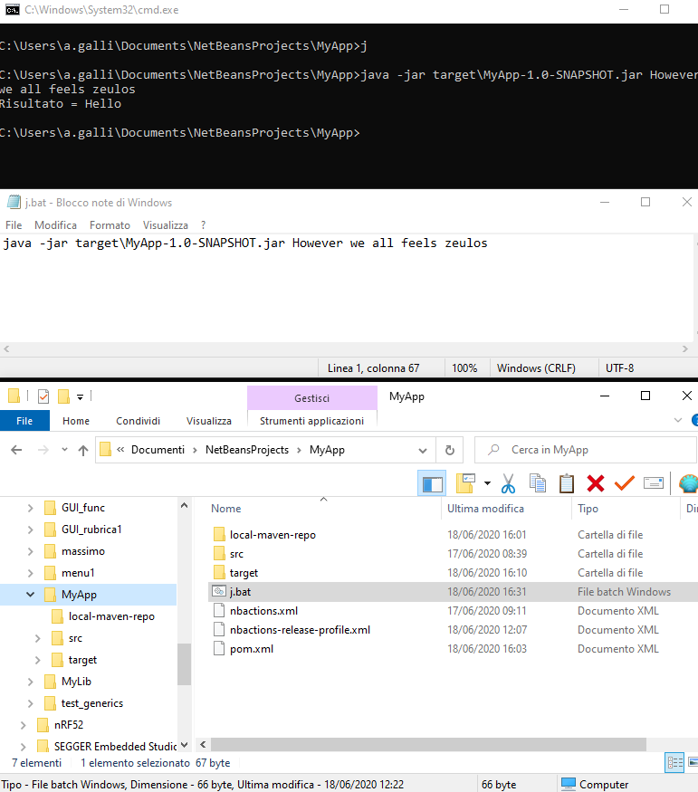
La chiamta da riga di comando usa «java –jar <nomefile.jar> xxxxx yyy zzzz (che sarebbero «args»)
java -jar target\MyApp-1.0-SNAPSHOT.jar However we all feels zeulos

